Slide 1



A Feature Selection Method Using Enhanced Pigeon Inspired Optimization with Mutation Operator for Intrusion Detection System
International Conference on Future Advances in Computing & Technology
Author Presentation Template

Slide 2
Presentation Outline
• Introduction
• Problem Statement
• Methodology
• Results
• Conclusion
• Future Work
• References

Slide 3
Abstract
This work proposes an enhanced feature selection technique combining Pigeon Inspired Optimization (PIO) with a Genetic Algorithm mutation operator.
Improves global search ability,
Avoids local optima problem
Uses SVM classifier
Evaluated on ADFA-LD, CICIDS2017, MQTT datasets
Results show improved detection accuracy and reduced false positive rate.

Slide 4
Need for Feature Selection
Feature selection plays a critical role in IDS performance.
• Removes irrelevant and redundant features
Reduces computational complexity
Improves training speed
Enhances classification accuracy
However, selecting optimal features is an NP-hard problem.

Slide 5
Introduction
Intrusion Detection Systems (IDS) are essential for modern network security.
Detect malicious activities in real-time
Protect cloud, IoT, and wireless networks
IDS types: Misuse-based and Anomaly-based
Challenge: Large datasets contain noise and redundant features affecting performance.

Slide 6
Problem Statement
Existing feature selection algorithms face major limitations:
Get trapped in local optima
High computational cost
Poor performance on complex datasets
Objective:
Develop a hybrid optimization technique to achieve global optimal feature selection.

Slide 7
Literature Survey 1
Genetic Algorithm + SVM:
Improves classification accuracy
Works well for structured datasets
Limitation:
High detection time
Increased computational cost

Slide 8
Literature Survey 2
Mutual Information + LSSVM:
Selects highly relevant features
Reduces false positives
Limitation:
Depends on ranking quality
May miss global optimal subset

Slide 9
Literature Survey 3
ABC + Adaboost / Hybrid Methods:
High accuracy (~98%)
Low false positive rate
Limitation:
Complex model design
Increased computational overhead

Slide 10
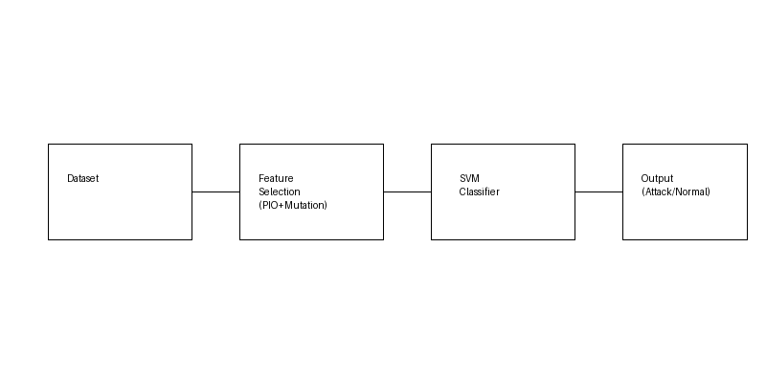
Proposed Methodology
Proposed Hybrid Model:
Binary Pigeon Inspired Optimization (PIO)
Genetic Algorithm Mutation Operator
Support Vector Machine (SVM)
Workflow:
Dataset → Feature Selection → Classification → Output

Slide 11
PIO Algorithm
Pigeon Inspired Optimization mimics bird navigation:
Map & Compass operator (global search)
Landmark operator (local refinement)
Advantages:
Fast convergence
Efficient global search

Slide 12
Mutation Operator
Mutation enhances diversity in search:
Flips binary values (0 ↔ 1)
Applied to low MI features
Benefits:
Avoids premature convergence
Improves exploration capability

Slide 13
SVM Classifier
Support Vector Machine:
Separates data using hyperplane
Uses RBF kernel for nonlinear classification
Advantages:
High accuracy
Effective in high-dimensional data

Slide 14
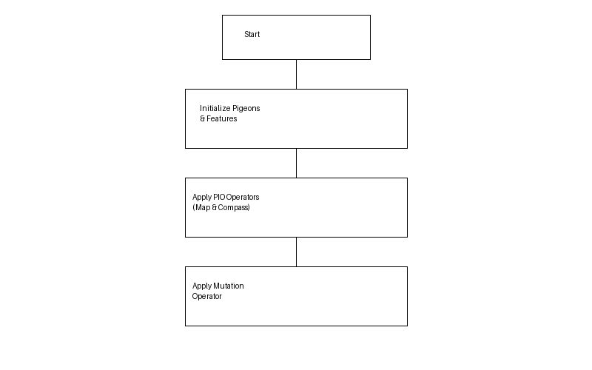
Flowchart of Proposed Method

Slide 15
Datasets Used
Datasets for evaluation:
ADFA-LD – real-world attack data
CICIDS2017 – modern network traffic
MQTT – IoT-based attacks
Evaluation Metrics:
Accuracy, Precision, Recall, F1-score, FPR

Slide 16
Results & Discussion
Performance Highlights:
• Higher accuracy compared to MI, GA, WOA, PIO
• Significant reduction in False Positive Rate
• Strong performance on CICIDS2017
Limitation:
Lower detection in minority classes due to imbalance

Slide 17
Table 1. Analysis of proposed method using CICIDS2017 dataset
Class | Test data size | Accuracy | Sensitivity | Specificity | Precision | F1-score
Benign | 1328 | 0.982616 | 0.973645 | 0.988383 | 0.981777 | 0.977694
DOS | 1600 | 0.997387 | 0.994375 | 1 | 1 | 0.99718
Portscan | 22 | 0.999127 | 1 | 0.999122 | 0.88 | 0.93617
Web attack | 13 | 1 | 1 | 1 | 1 | 1
Ftp_parator | 160 | 0.991915 | 0.9625 | 0.993339 | 0.875 | 0.916667
Ssh_parator | 377 | 0.991056 | 0.960212 | 0.99482 | 0.957672 | 0.95894

Slide 18
Table 2. Validation of proposed method with other feature selection methods on the basis of FPR using various intrusion datasets
Dataset | Mutual Information | Genetic algorithm | Whale Optimization algorithm | Traditional PIO | Proposed method
ADFA-LD | 0.133 | 0.0675 | 0.043 | 0.013 | 0.004
CICIDS2017 | 0.0041 | 0.009 | 0.003 | 0.002 | 0.002
MQTT | 0.0021 | 0.004 | 0.004 | 0.0014 | 0.000046
Table 3. Validation of enhanced PIO with K-fold cross validation technique
Dataset | Accuracy
ADFA-LD | 97.11 ± 0.80
CICIDS2017 | 99.1 ± 0.25
MQTT | 99.99 ± 0.0001

Slide 19
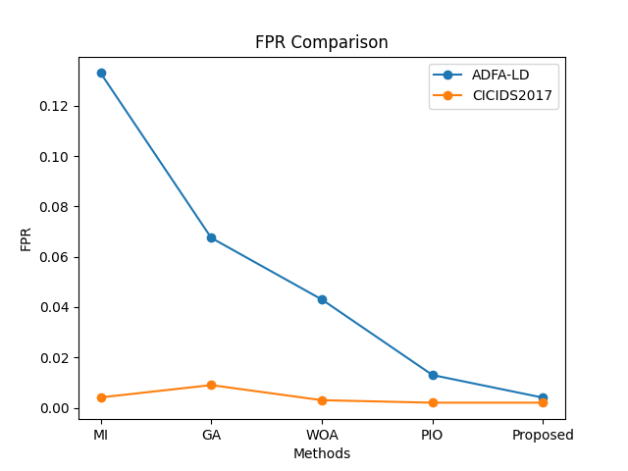
FPR Comparison Graph

Slide 20
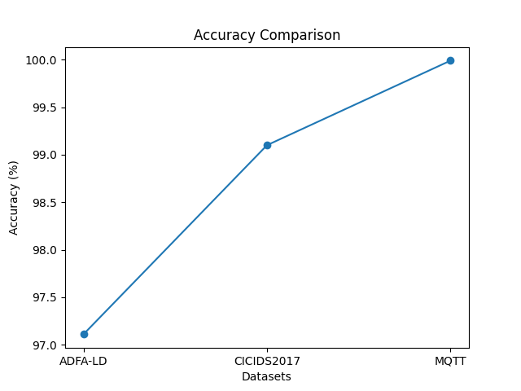
Accuracy Comparison Graph

Slide 21
Conclusion
• Enhanced PIO with mutation improves IDS performance
Achieves better global optimization
Reduces false positives
Future Work:
Handle class imbalance (SMOTE)
Real-time deployment in networks

Slide 22
References:
[1]H. Nguyen, G. Scalosub, and R. Zheng, “On quality of monitoring for multichannel wireless infrastructure networks,” IEEE Trans. Mobile Comput., vol. 13, no. 3, pp. 664–677, 2014.
[2]R. Perdisci, G. Giacinto, and F. Roli, “Alarm clustering for intrusion detection system in computer networks,” Eng. Appl. Artif. Intell., vol. 19, no. 4, pp. 429–438, 2006.
[3]M. Dash, H. Liu, and H. Motoda, “Consistency based feature selection,” Lect. Notes Comput. Sci., vol. 1805, pp. 98–109, 2003.
[4]M. Montazeri, M. Montazeri, H. R. Naji, and A. Faraahi, “A novel memetic feature selection algorithm,” in Proc. 5th Conf. Inf. Knowl. Technol., May 2013, pp. 295–300.
[5]H. Liu and H. Motoda, *Feature Selection for Knowledge Discovery and Data Mining*, The Springer International Series in Engineering and Computer Science, vol. 454. New York, NY, USA: Springer, 1998, 224 pp.
[6]M. A. Hall, “Correlation-based feature selection for machine learning,” Ph.D. dissertation, Univ. Waikato, Hamilton, New Zealand, 1999.
[7]L. Cao, L. Xu, and E. D. Goodman, “A guiding evolutionary algorithm with greedy strategy for global optimization problems,” Comput. Intell. Neurosci., vol. 2016, pp. 1–10, 2016.
[8]R. Vijayanand, D. Devaraj, and B. Kannapiran, “A novel intrusion detection system for wireless mesh network with hybrid feature selection technique based on GA and MI,” J. Intell. Fuzzy Syst., vol. 34, no. 1, pp. 1243–1250, 2018.
[9]C. Huang and C. Wang, “A GA based feature selection and parameter optimization for support vector machines,” Expert Syst., vol. 31, pp. 231–240, 2006.
[10]Vijayanand. R and Devaraj. D, “A novel feature selection method using whale optimization algorithm and genetic operators for intrusion detection system in wireless mesh network”, IEEE Access, March 2020. DOI: 10.1109/ACCESS.2020.2978035.

Slide 23
Thank You
Questions?

